Slide 1
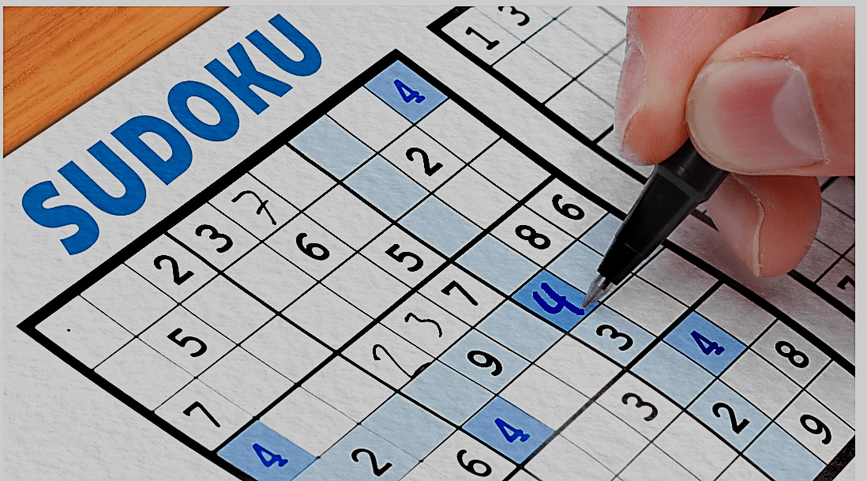
Sudoku Solver Visualizer

Slide 2
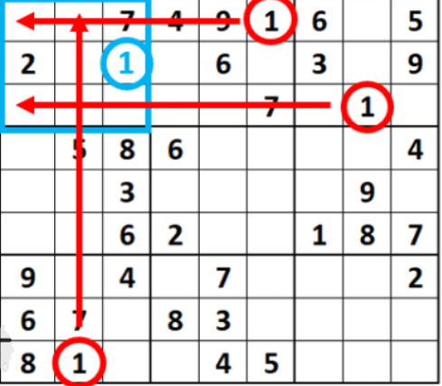
Overview
Sudoku is a popular number puzzle game that involves filling a 9x9 grid with digits from 1 to 9.
Each row, column, and 3x3 subgrid must contain each digit exactly once.

Slide 3
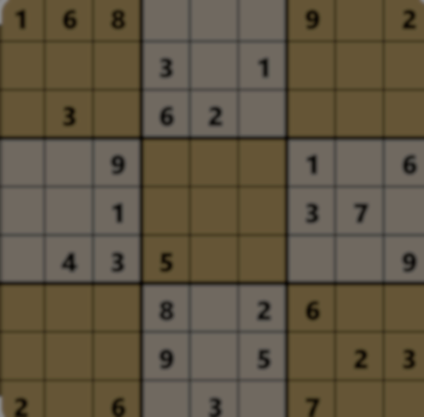
Purpose of the Project:
To develop a visual tool that can solve Sudoku puzzles.
Helps in understanding the backtracking algorithm used to solve Sudoku.
Visualizes the process of solving the puzzle step by step.
Key Features:
User-friendly graphical interface using Java Swing.
Ability to input custom Sudoku puzzles.
Option to fill the grid with random values.
Visual representation of the solving process.

Slide 4
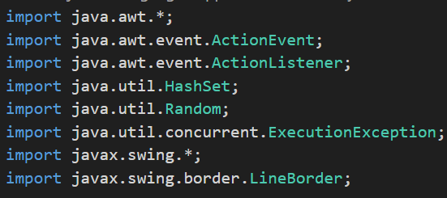
Project Setup and Components
Development Environment:
Integrated Development Environment (IDE): Visual Studio Code.
Programming Language: Java.
Additional Libraries: Java Swing
for GUI,Java AWT for event handling.
Main Components:
GUI Components:
JFrame: Main window for the application.
JPanel: Grid panel to display the Sudoku board.
Buttons: Solve, Clear, and Fill Random buttons for user interaction.

Slide 5
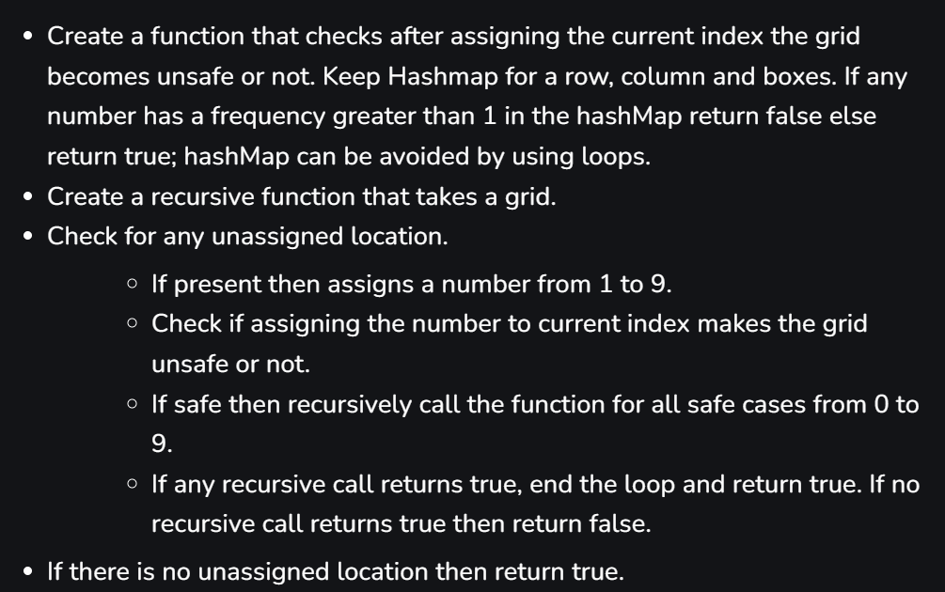
Logic Components:
Backtracking Algorithm: Core logic for solving the Sudoku puzzle.
Validation Functions: Ensure the puzzle is valid during the solving process.
Random Fill Function: Populates the grid with random numbers.
Class Structure:
SudokuSolver: Main class extending JFrame.
SudokuBoard: Class representing the Sudoku grid.
SudokuSolverLogic: Class containing the backtracking algorithm.

Slide 6
GUI Implementation
Creating the Main Window:
Setting up the JFrame with a title, size, and default close operation.
Adding a JPanel to hold the Sudoku grid.
Designing the Sudoku Grid:
Using a GridLayout to arrange cells in a 9x9 format.
Each cell is represented by a JTextField for user input.

Slide 7
Adding Control Buttons:
Solve Button:
Triggers the solving process when clicked.
Clear Button:
Clears the Sudoku grid.
Fill Random Button:
Fills the grid with random numbers for testing.
Event Handling:
ActionListeners for button clicks.
Real-time validation of user inputs in the JTextFields.

Slide 8
Backtracking Algorithm
Overview of Backtracking:
A recursive algorithm for solving constraint satisfaction problems.
Tries different possibilities and backtracks when a constraint is violated.
Algorithm Steps:
Start from the first empty cell.
Try filling the cell with numbers 1 to 9.
Check if the number is valid (does not violate Sudoku rules).
If valid, move to the next empty cell and repeat.
If no valid number is found, backtrack to the previous cell and try the next number.

Slide 9
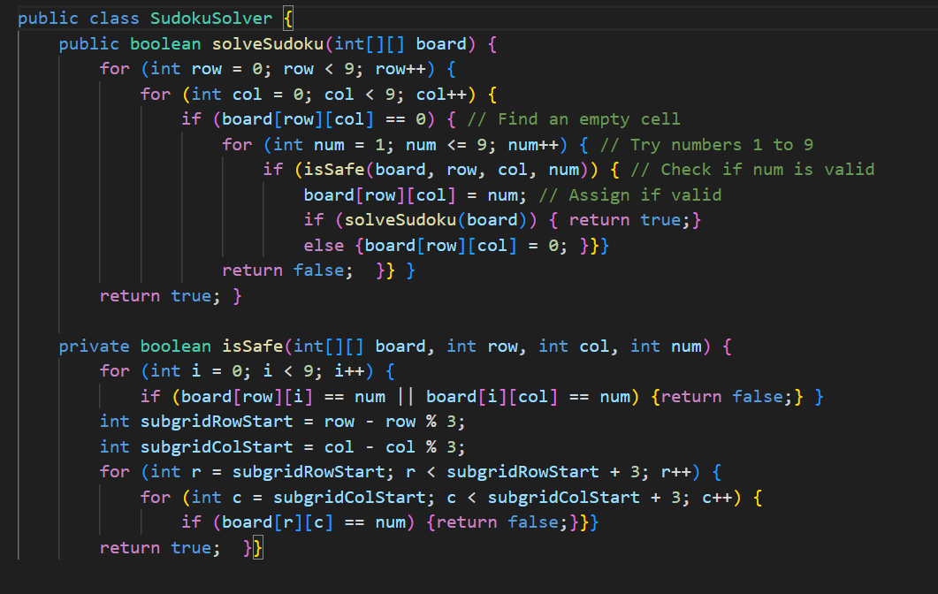

Slide 10
Implementation in Java:
Recursive function solveSudoku(int[][] board).
Validation functions isValid(int[][] board, int row, int col, int num).
Base case: All cells are filled correctly.
Visualization:
Highlighting the current cell being processed.
Displaying intermediate steps to show the backtracking process.

Slide 11
Demonstration and Conclusion
Live Demonstration:
Show the Sudoku Solver Visualizer in action.
Demonstrate solving a custom Sudoku puzzle.
Use the Fill Random feature to show the solver's capability.
Key Takeaways:
Understanding of the backtracking algorithm and its application to Sudoku.
Importance of visual tools in learning and debugging algorithms.
Practical experience in Java Swing for GUI development

Slide 12
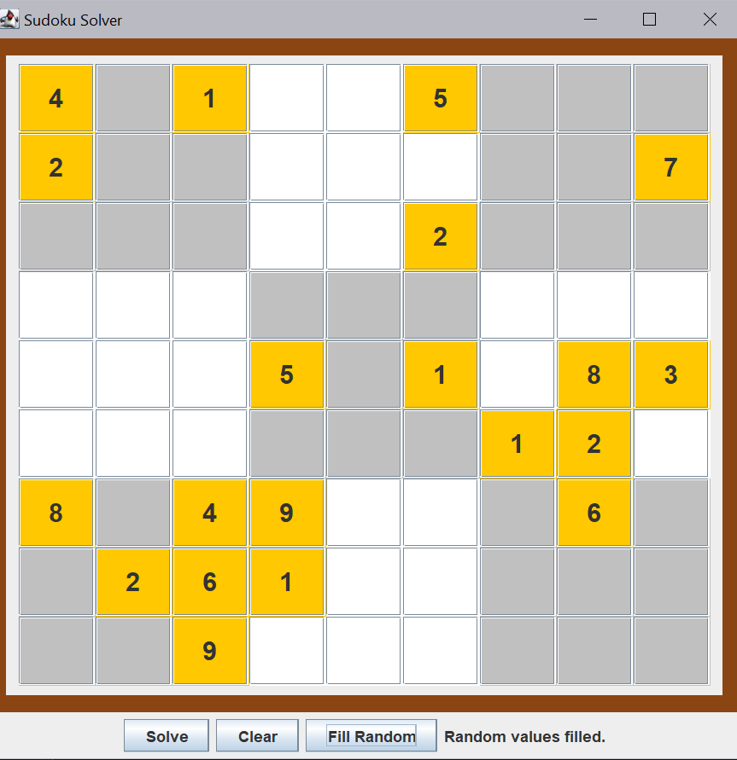
Random values can be shown or fill automatically
when u click on the fill random (20 values) button

Slide 13
